Slide 1
"Exploring Customer Trends, Profitability, and Growth Opportunities"
Team Members:
Sultan Mahmood Riaz,
Svitlana Kovalivska,
Solomon Appiah Kubi,
Bilyana Jüngling,
Anthony Godwin Edoro,
Sumi Dhakal
Links: Sales Data Analysis Summary
SQL Findings,
Spreadsheet Findings,
Tableau Dashboard,
Video,
Additional Business Metrics

Slide 2
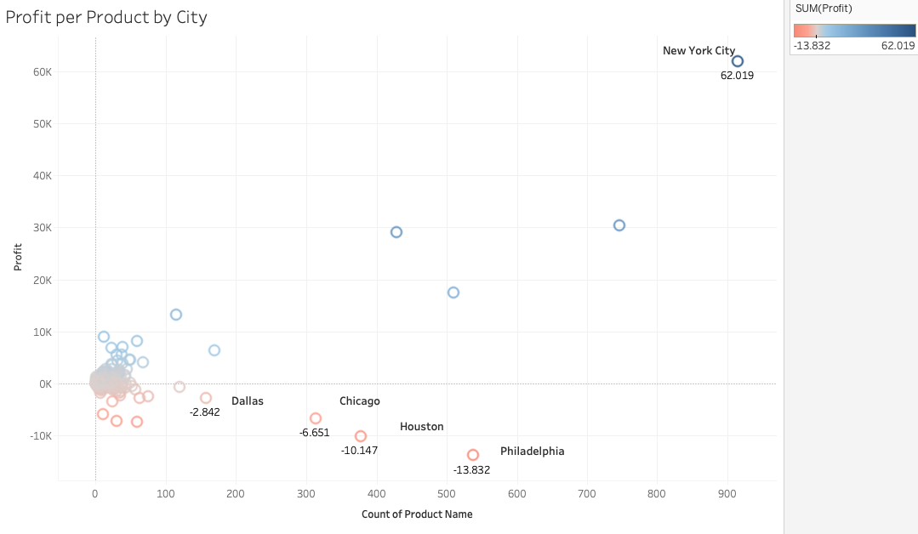
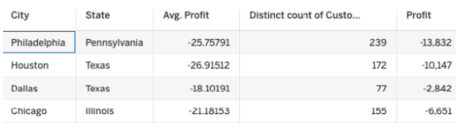
Problem Statement: High Customer Count v.s. Low Profitability
Finding: Cities like Houston, Philadelphia, Chicago and Dallas, despite having more than 77 customers, remain loss-making, while New York shows the highest profit per customer. There's a clear gap in profit per customer, from New York's 62.019 to Philadelphia's -13.832.
What to check: Seasonality, Sub Category, Discount, Delivery time, Quality of Products

Slide 3
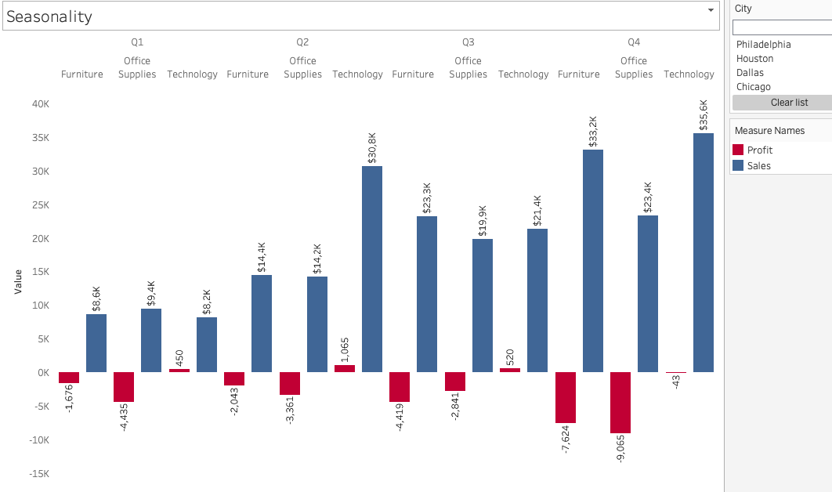
Seasonal Sales Spike
Finding: Quarter 4 experiences a noticeable sales spike, but profit growth is limited.
Insight: High discounts and seasonal marketing costs likely reduce profit margins during peak sales periods.

Slide 4
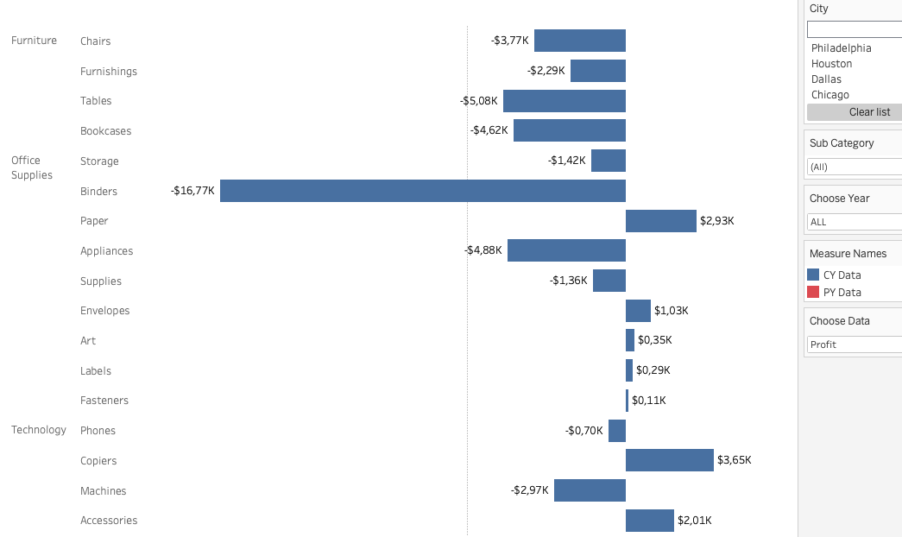
Binders and Tables Subcategory of chousen Cities impacts on Profitability

Slide 5
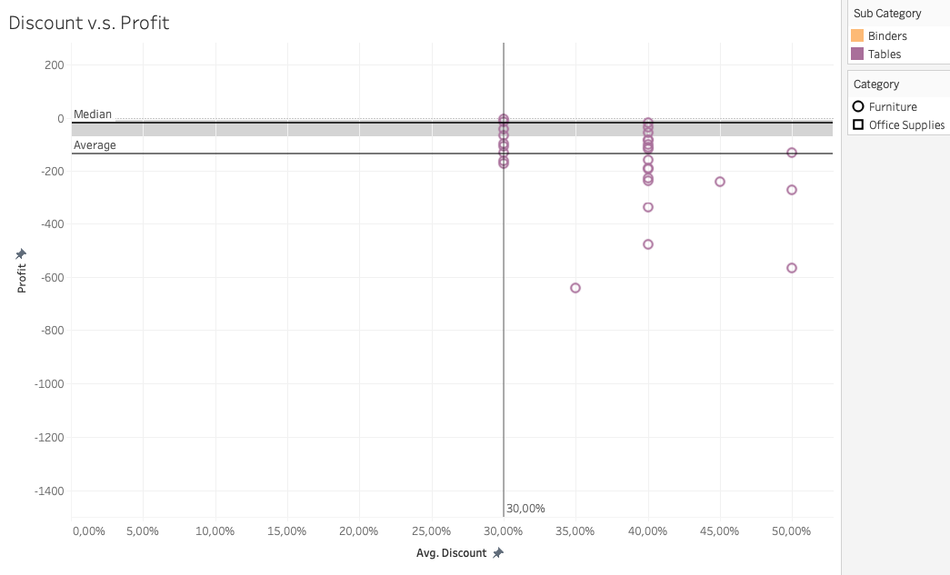
Discount Impacts on Profitability
Finding: Discounts above 30% are detrimental to profitability, especially in the Furniture and Office Supplies categories.
Insight: Even with a modest 0.3% discount on Tables, profitability is negative, suggesting potential issues.

Slide 6
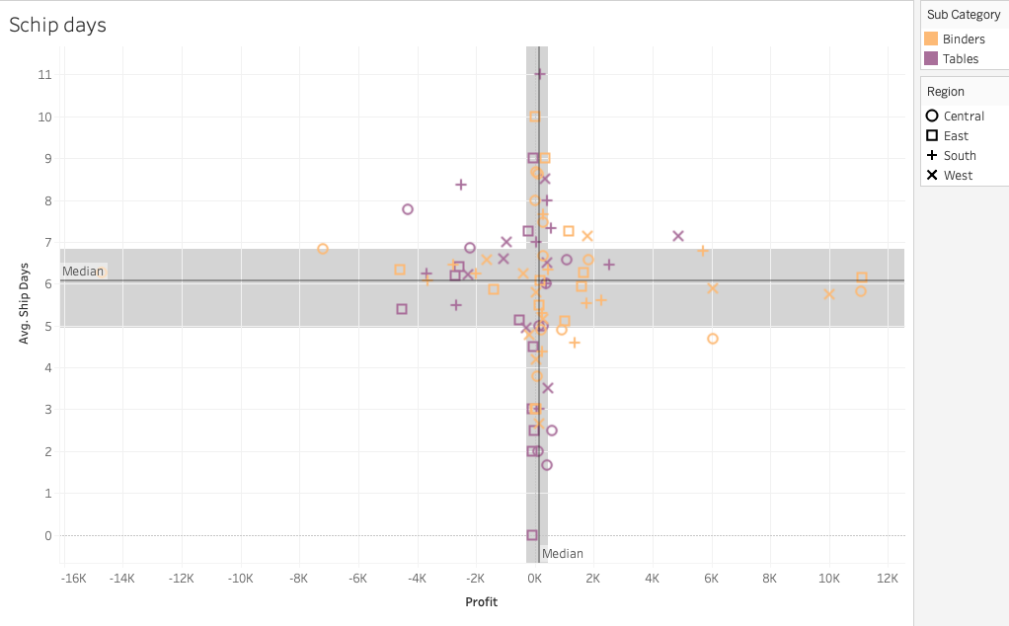
Delivery Times and Profit Impact
Finding: Long delivery times of Tables and Binders in regions like Pennsylvania, Ohio, and Florida hurt profitability.
Insight: For tables, delivery delays over 5 days lead to higher costs and lower customer satisfaction.

Slide 7
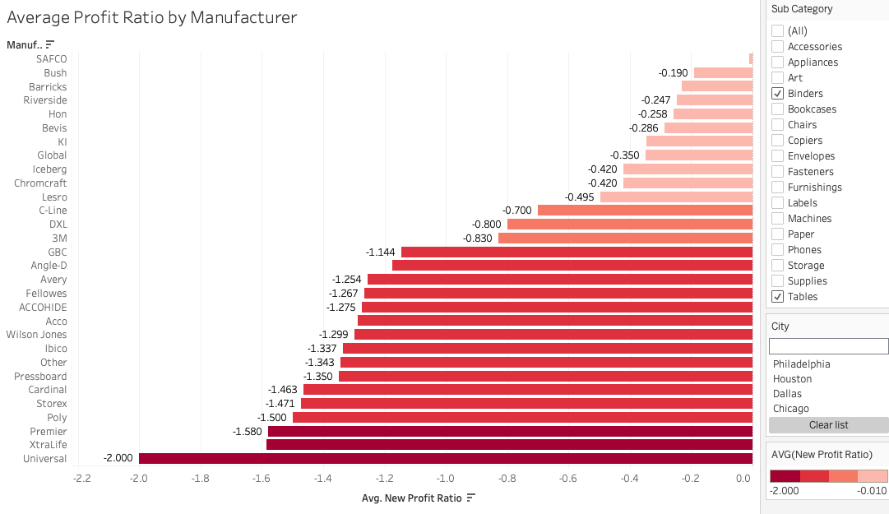
Quality of Products by Manufacturers in chosen Subcategory may influence on Return Rate

Slide 8
Recommendations
Focus on Profitability of Cities: Rethink strategy for high-customer, low-profit cities like Houston and Philadelphia.
Optimize Delivery & Product Strategy: Shorten delivery times in targeted regions and enhance Furniture and Office Supplies offerings.
Enhance Seasonal & Discount Strategies: Targeted Quarter 4 promotions, and restrict discounts to under 30% for key categories limit or less for the most sensitive categories and consider tiered discounts for lower-demand products.
Establish a Quality-Based Supplier Optimization Program focused on improving the profitability.

Slide 9
Key Lessons Learned for Effective Project Management
Harnessing Collective Strengths. Teamwork vs. Individual Work: Collaboration fosters innovation and enhances problem-solving capabilities.
The Power of Emotional Intelligence. Emotional Intelligence in Team Dynamics: Empathy and understanding create a supportive environment, boosting team morale.
Ensuring Excellence Through Delegation. Quality Management and Delegation: Clear task delegation empowers team members and maintains high-quality standards.
Precision in Problem Solving. Focused Problem Analysis: Addressing specific challenges leads to effective solutions and maximizes resource use.
Streamlined Insights for Better Decisions. Dashboard Simplicity and Usability: Intuitive dashboards provide actionable insights, making data-driven decisions easier.

Slide 10
Thank You!

